Slide 1
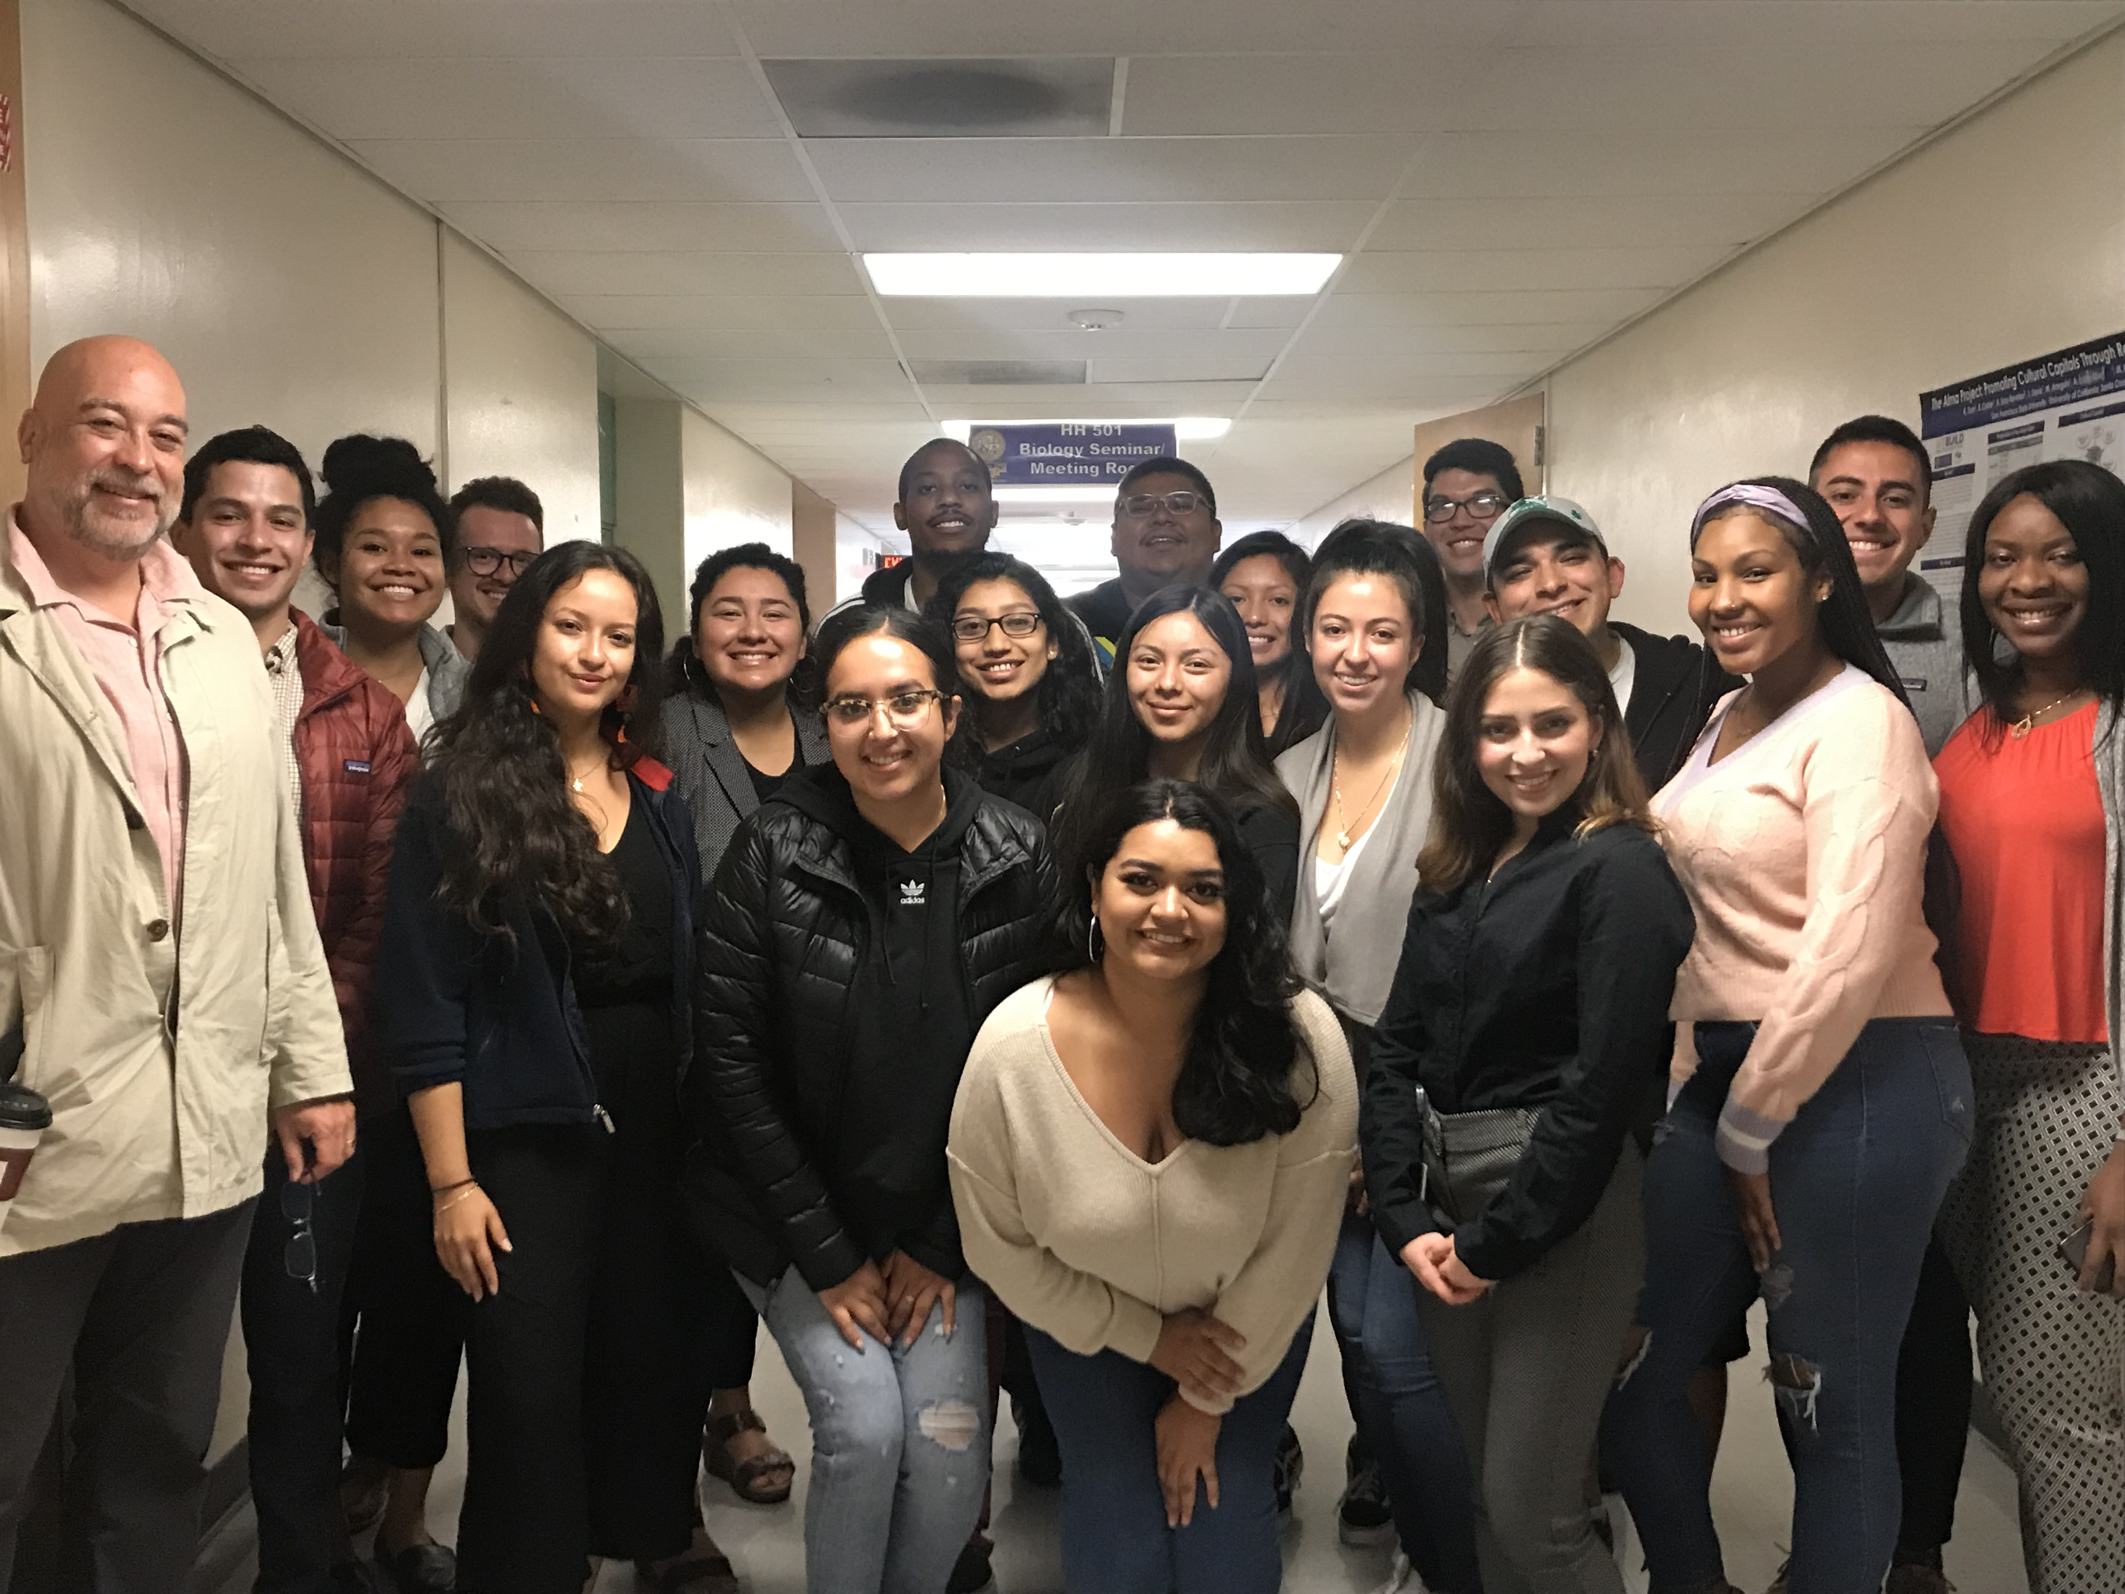
UCSF Latinx Center of Excellence (LCOE) of
Aspiring Physicians Program (APP) at
Fresno State & San Francisco State
November 16, 2020
APP Faculty, staff and alumni
Notes:
Kelechi

Slide 2
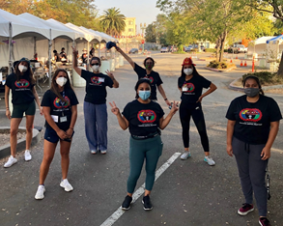
OBJECTIVES
Introduce the LCOE and APP program and staff – 10 min
Understand the purpose & commitment of the APP program – 15 min
Explain eligibility – HRSA grant limitations – 5 min
Alumni Panel Q&A- 20 min
Respond to questions about the application process – 10 min
Notes:
Kelechi

Slide 3
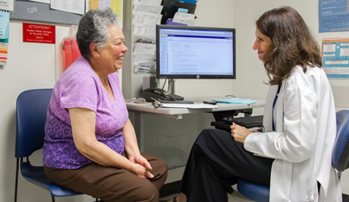
BACKGROUND
UCSF LCOE was established in 2018
PI and Director, Dr. Alícia Fernandez, General Internist at ZSFG
Grant awarded by U.S. Department of Health & Human Services (HHS) Health Resources & Services Administration (HRSA) with additional funds from UCSF School of Medicine
We partnered with SFSU and Fresno State to provide extra support to pre-medical students who need more resources to successfully apply and gain admittance to medical school
Notes:
Leslie
($680 per year plus $50k from SOM = approx. $3 Million )

Slide 4
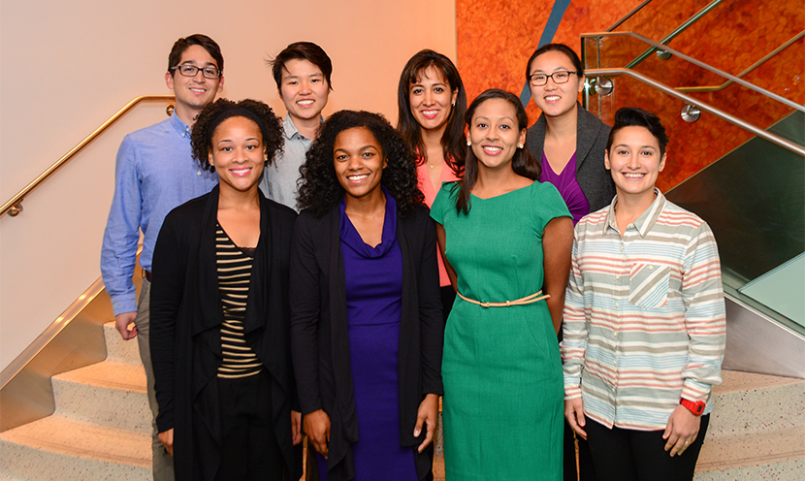
LCOE VISION:
A healthy society where all receive equitable and high quality, culturally competent healthcare.
LCOE MISSION:
To improve the health and healthcare of California through the development of diverse physician leaders and through research, education and advocacy.
Notes:
Carla

Slide 5
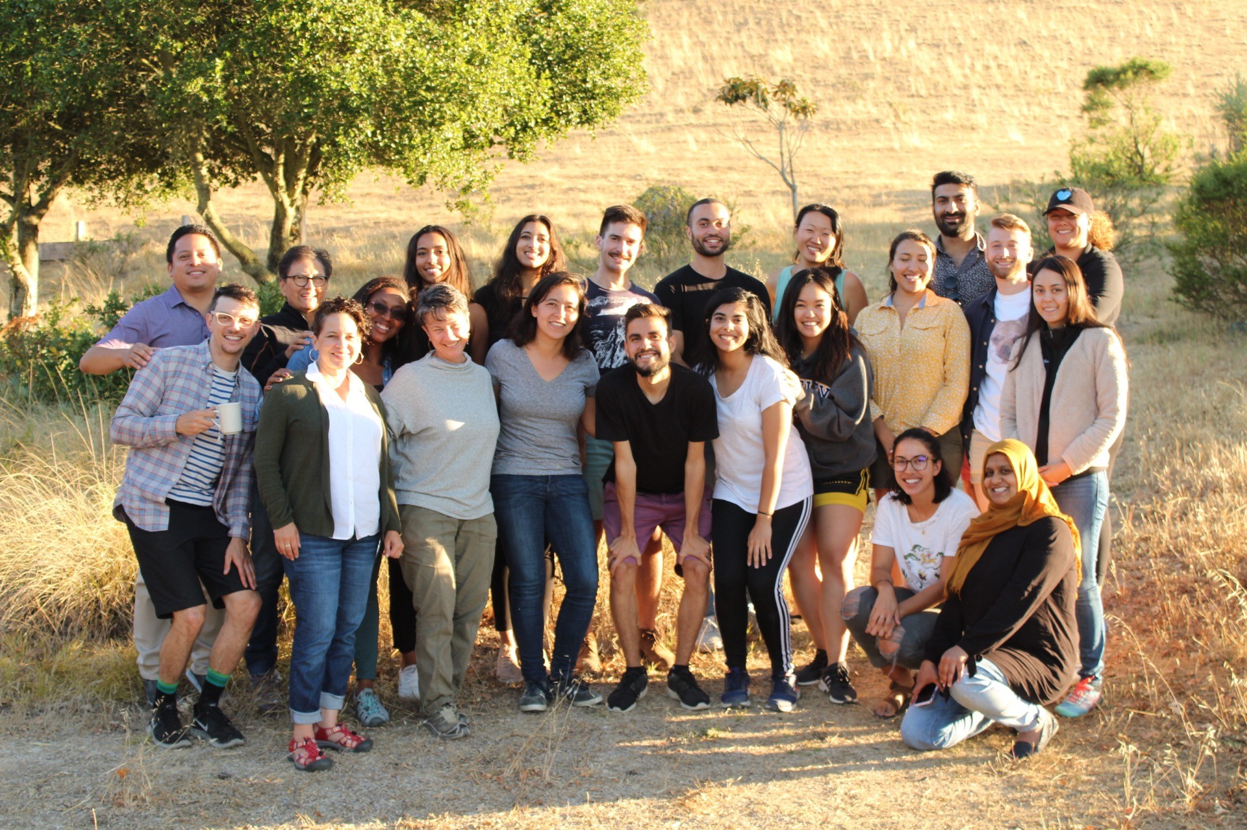
LCOE GOALS:
To foster the development of diverse physician leaders
To promote cultural competence in medical education for all trainees
To leverage UCSF, community and state collective capacity to improve California’s health and healthcare
To provide expertise on Latinx health and health disparities
To advocate for the health of California’s diverse communities
Notes:
Carla

Slide 6
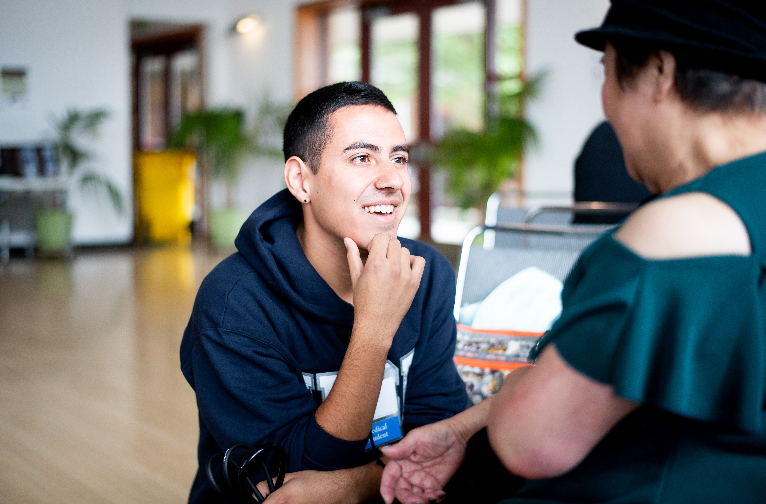
LCOE Aspiring Physicians
Program (APP)
PURPOSE: 6 -week Summer Program
Students will gain exposure to:
Health policy & writing fact sheets
Local community-based organizations
Introductory MCAT preparation
Guest speakers and medical school panelists
How to prepare medical school application (AMCAS)
FUEGO
Enhances UCSF ability to recruit, retain, and promote Latinx & UIM faculty
Notes:
Kathy

Slide 7
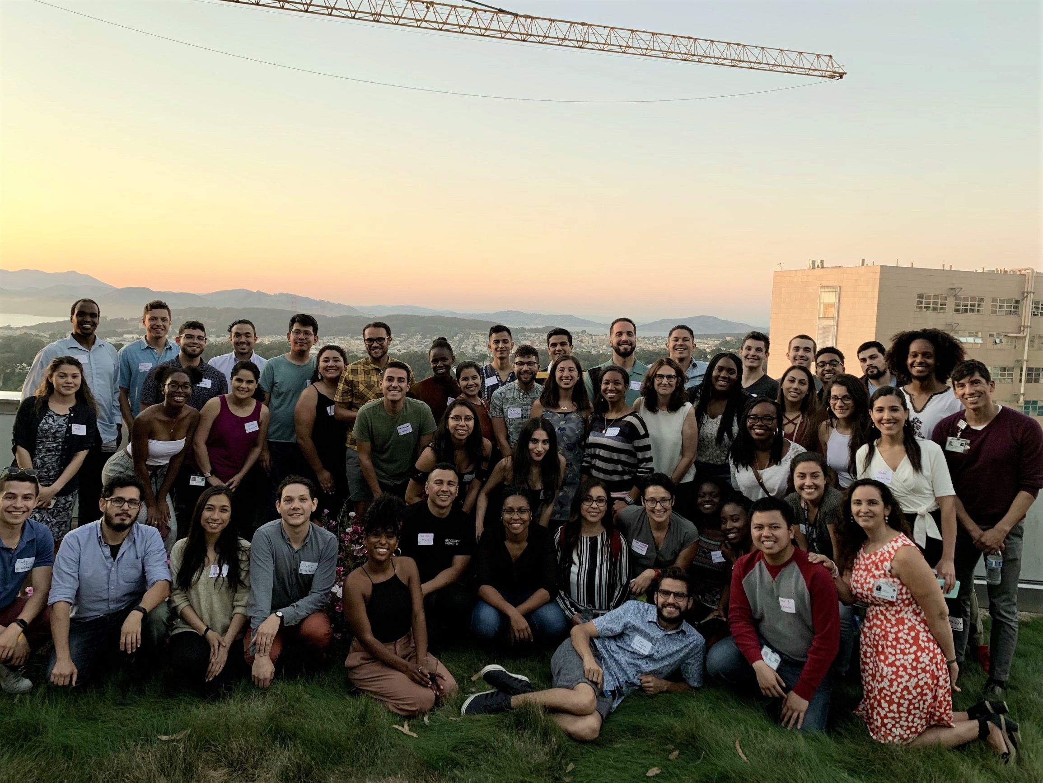
LCOE Aspiring Physicians Program (APP)
PURPOSE: Academic Year Program
Workshops on student professional development
Mentorship support
Student advising with APP faculty
Speaker Series
Fostering community between scholars and creating networking opportunities
FUEGO
Enhances UCSF ability to recruit, retain, and promote Latinx & UIM faculty
Notes:
Tomás

Slide 8
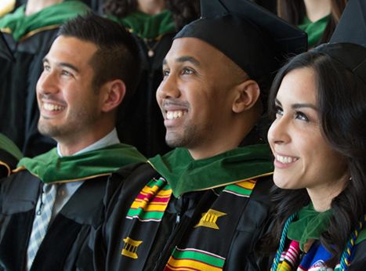
Eligibility Requirements
Must be a full-time Fresno State OR San Francisco State Undergraduate Student
Plan to apply to medical school
Commit a minimum of one academic year to the program – including the six week summer program
A cumulative GPA of 3.0 or higher
Taken one year of Biology and Chemistry by the start of the summer program
U.S. citizen, U.S. permanent resident, or DACA status
Notes:
Connie

Slide 9
Eligibility: continued
Due to HRSA funding for this program, we have strict
limitations on program eligibility
Fresno State Specific
I identify as Hispanic/Latinx (which is underrepresented in medicine), OR two or more races/ethnicities when one is Hispanic/Latinx
San Francisco State Specific
I identify as Hispanic/Latinx, African American (both underrepresented in medicine), OR two more races/ethnicities when one is Hispanic/Latinx
Notes:
Kathy - FSU
Tomás - SFSU

Slide 10



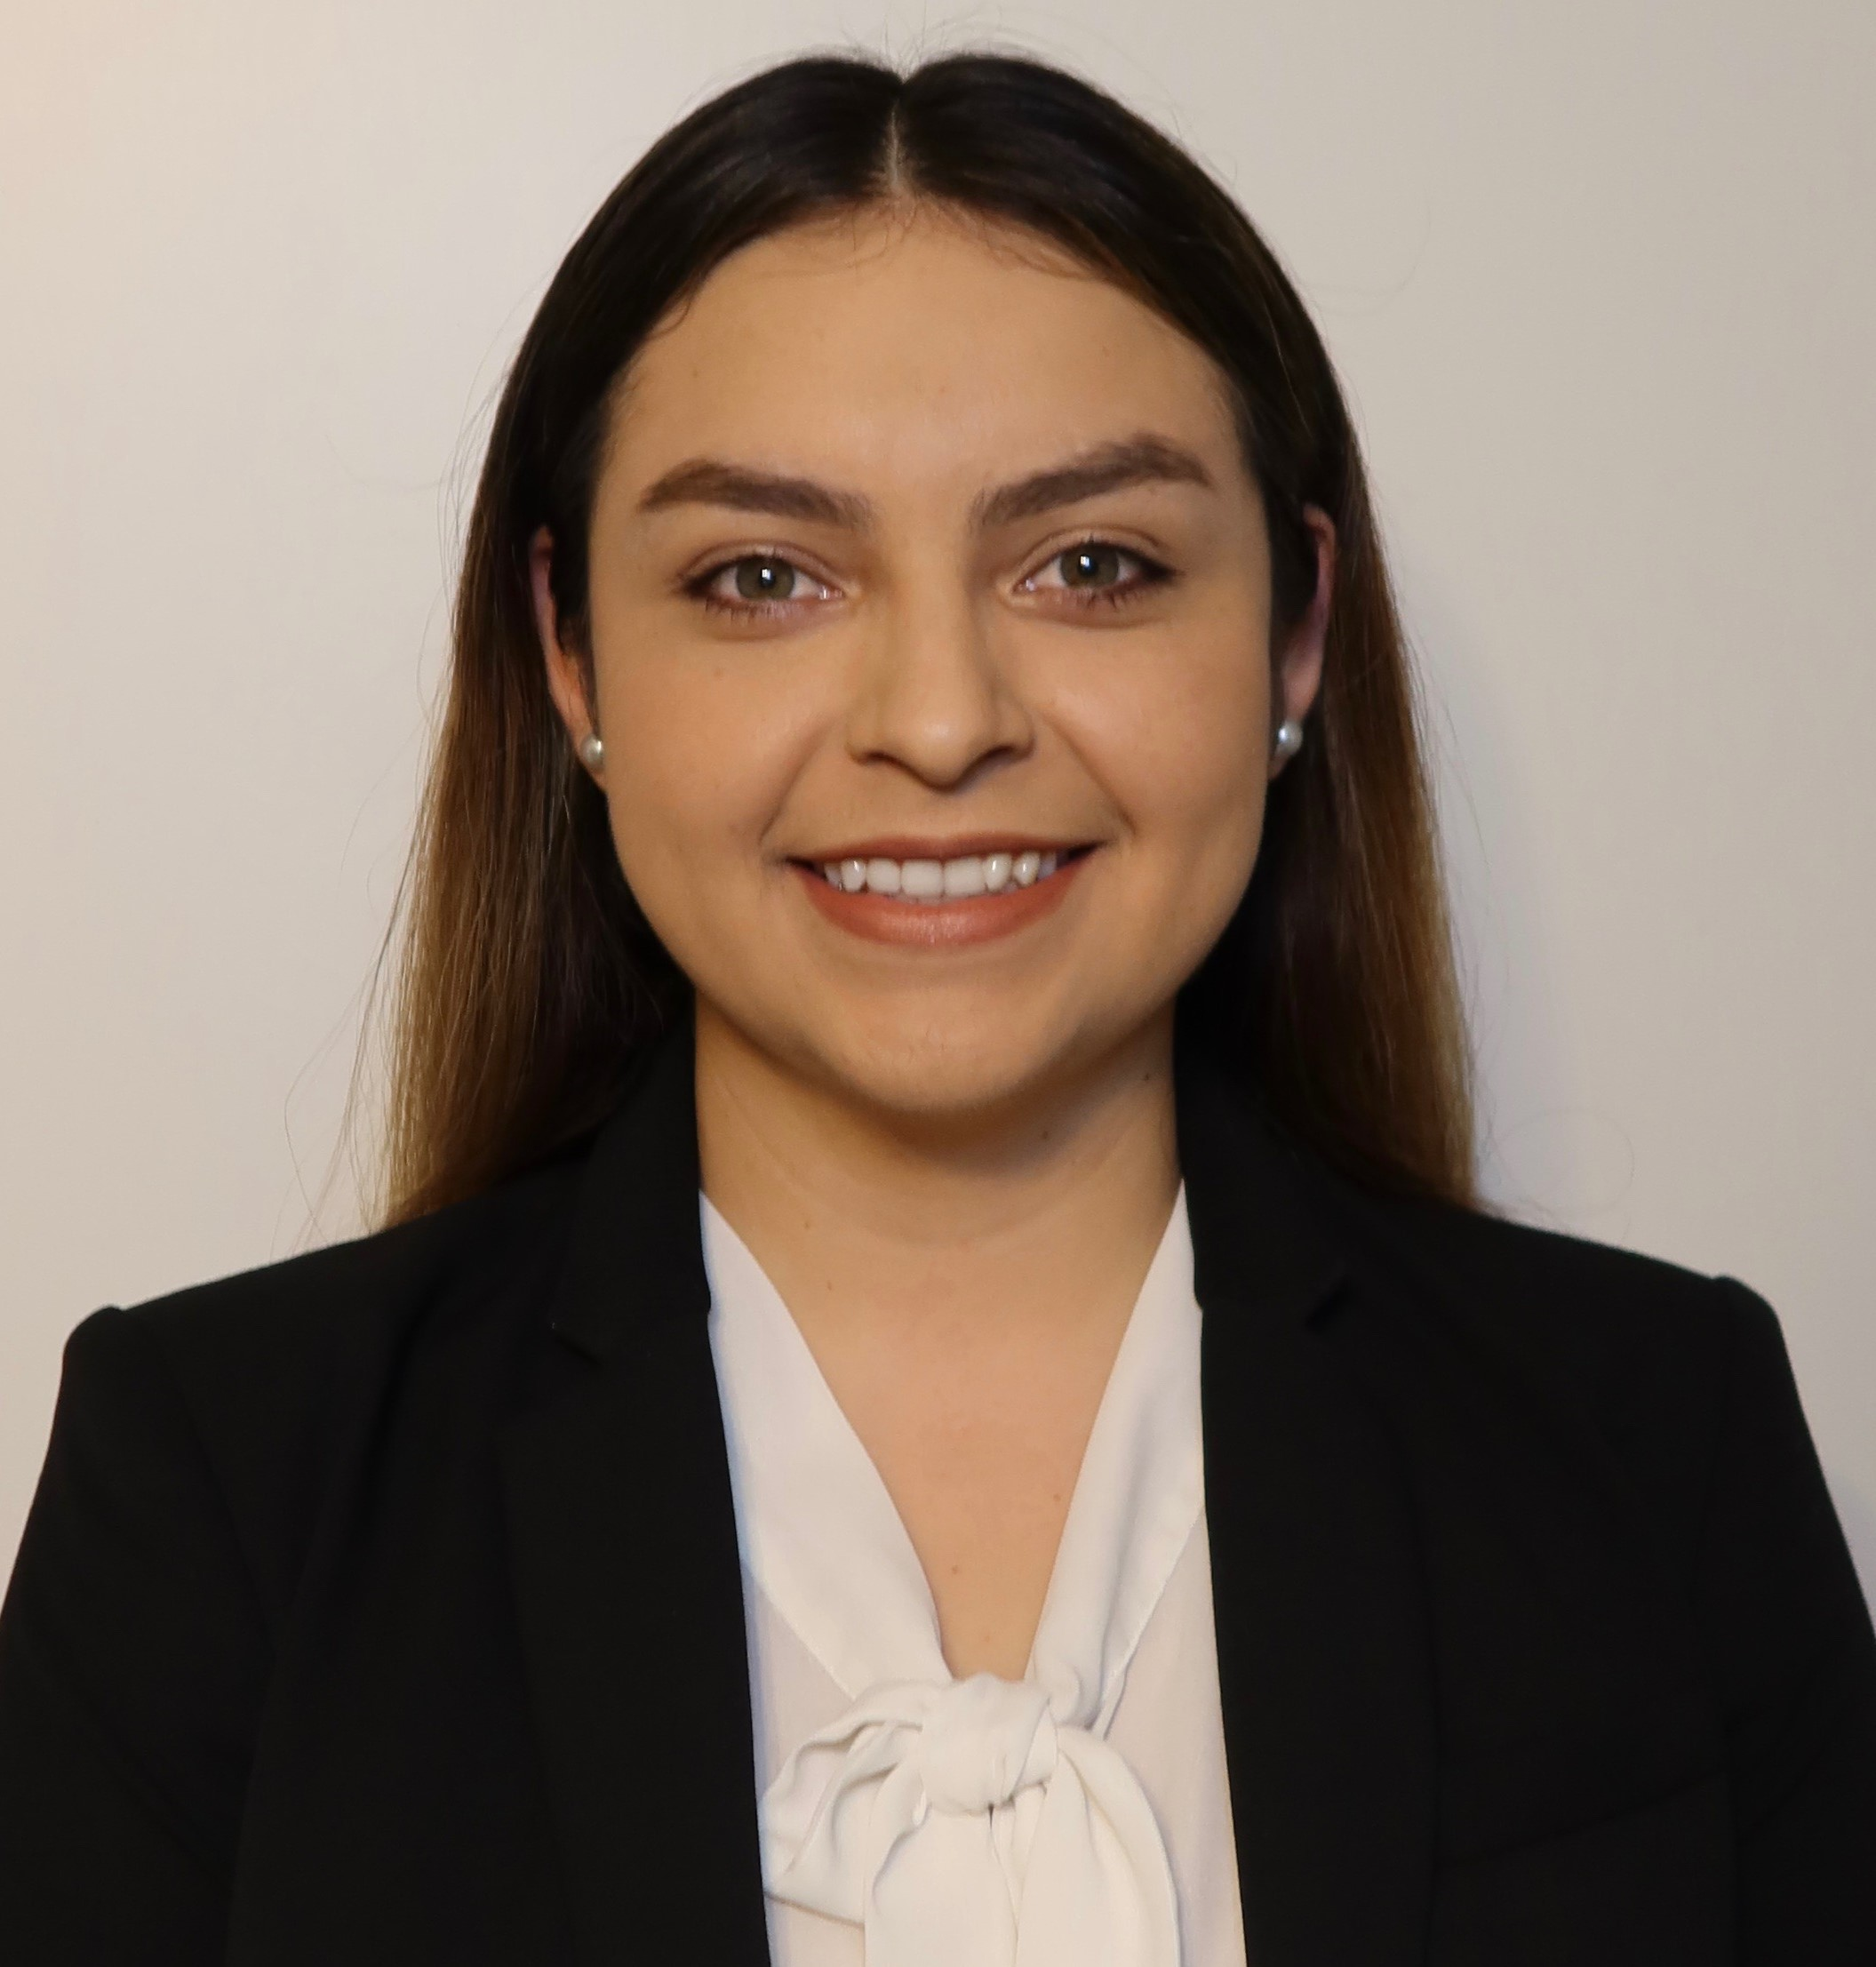
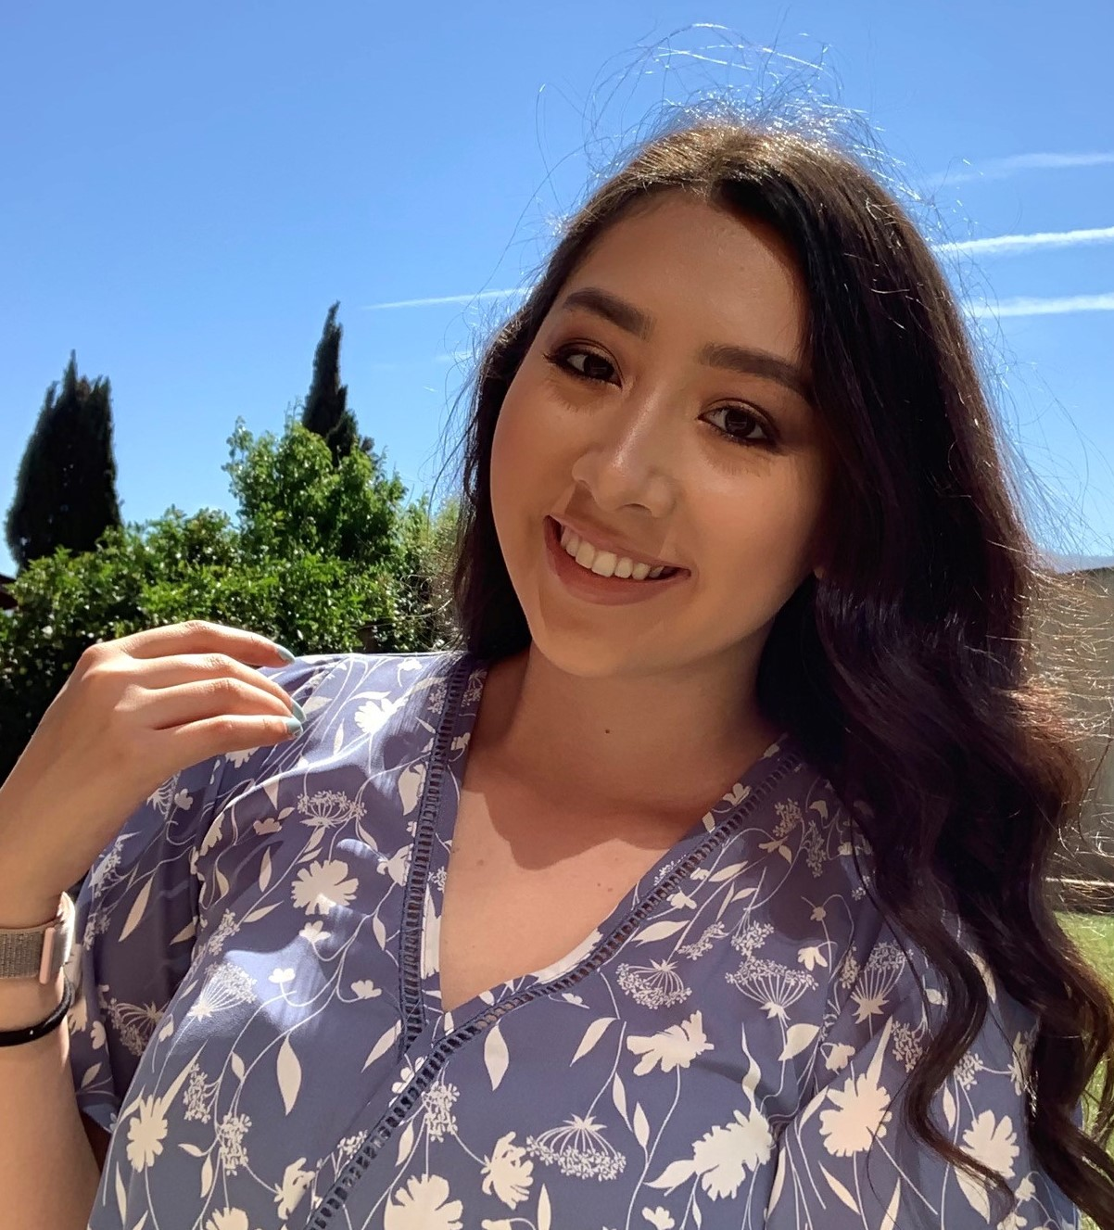
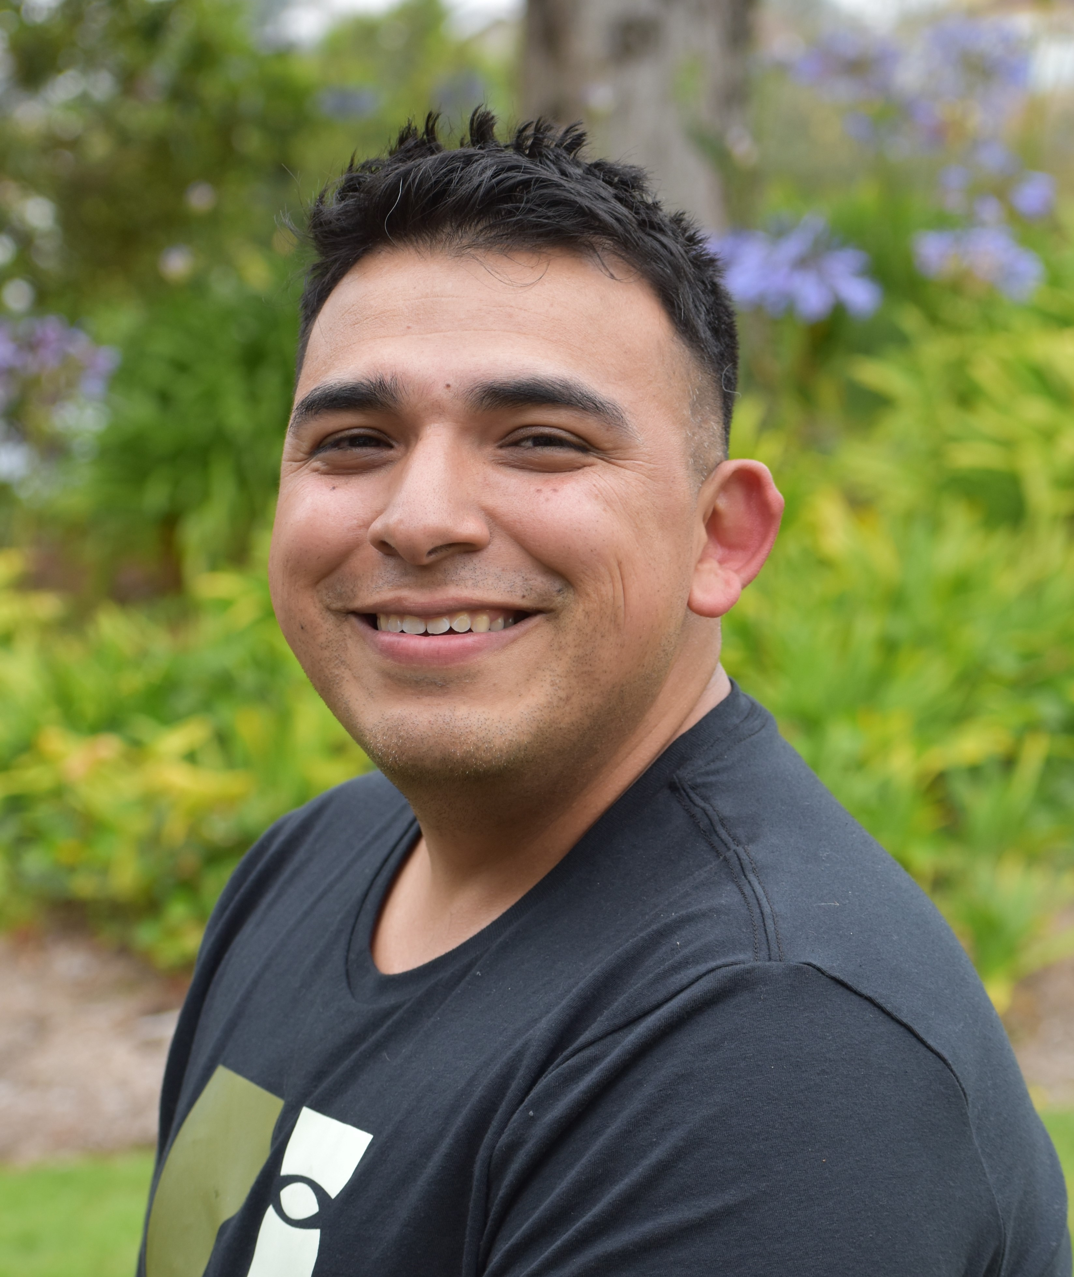
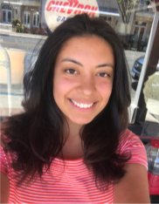
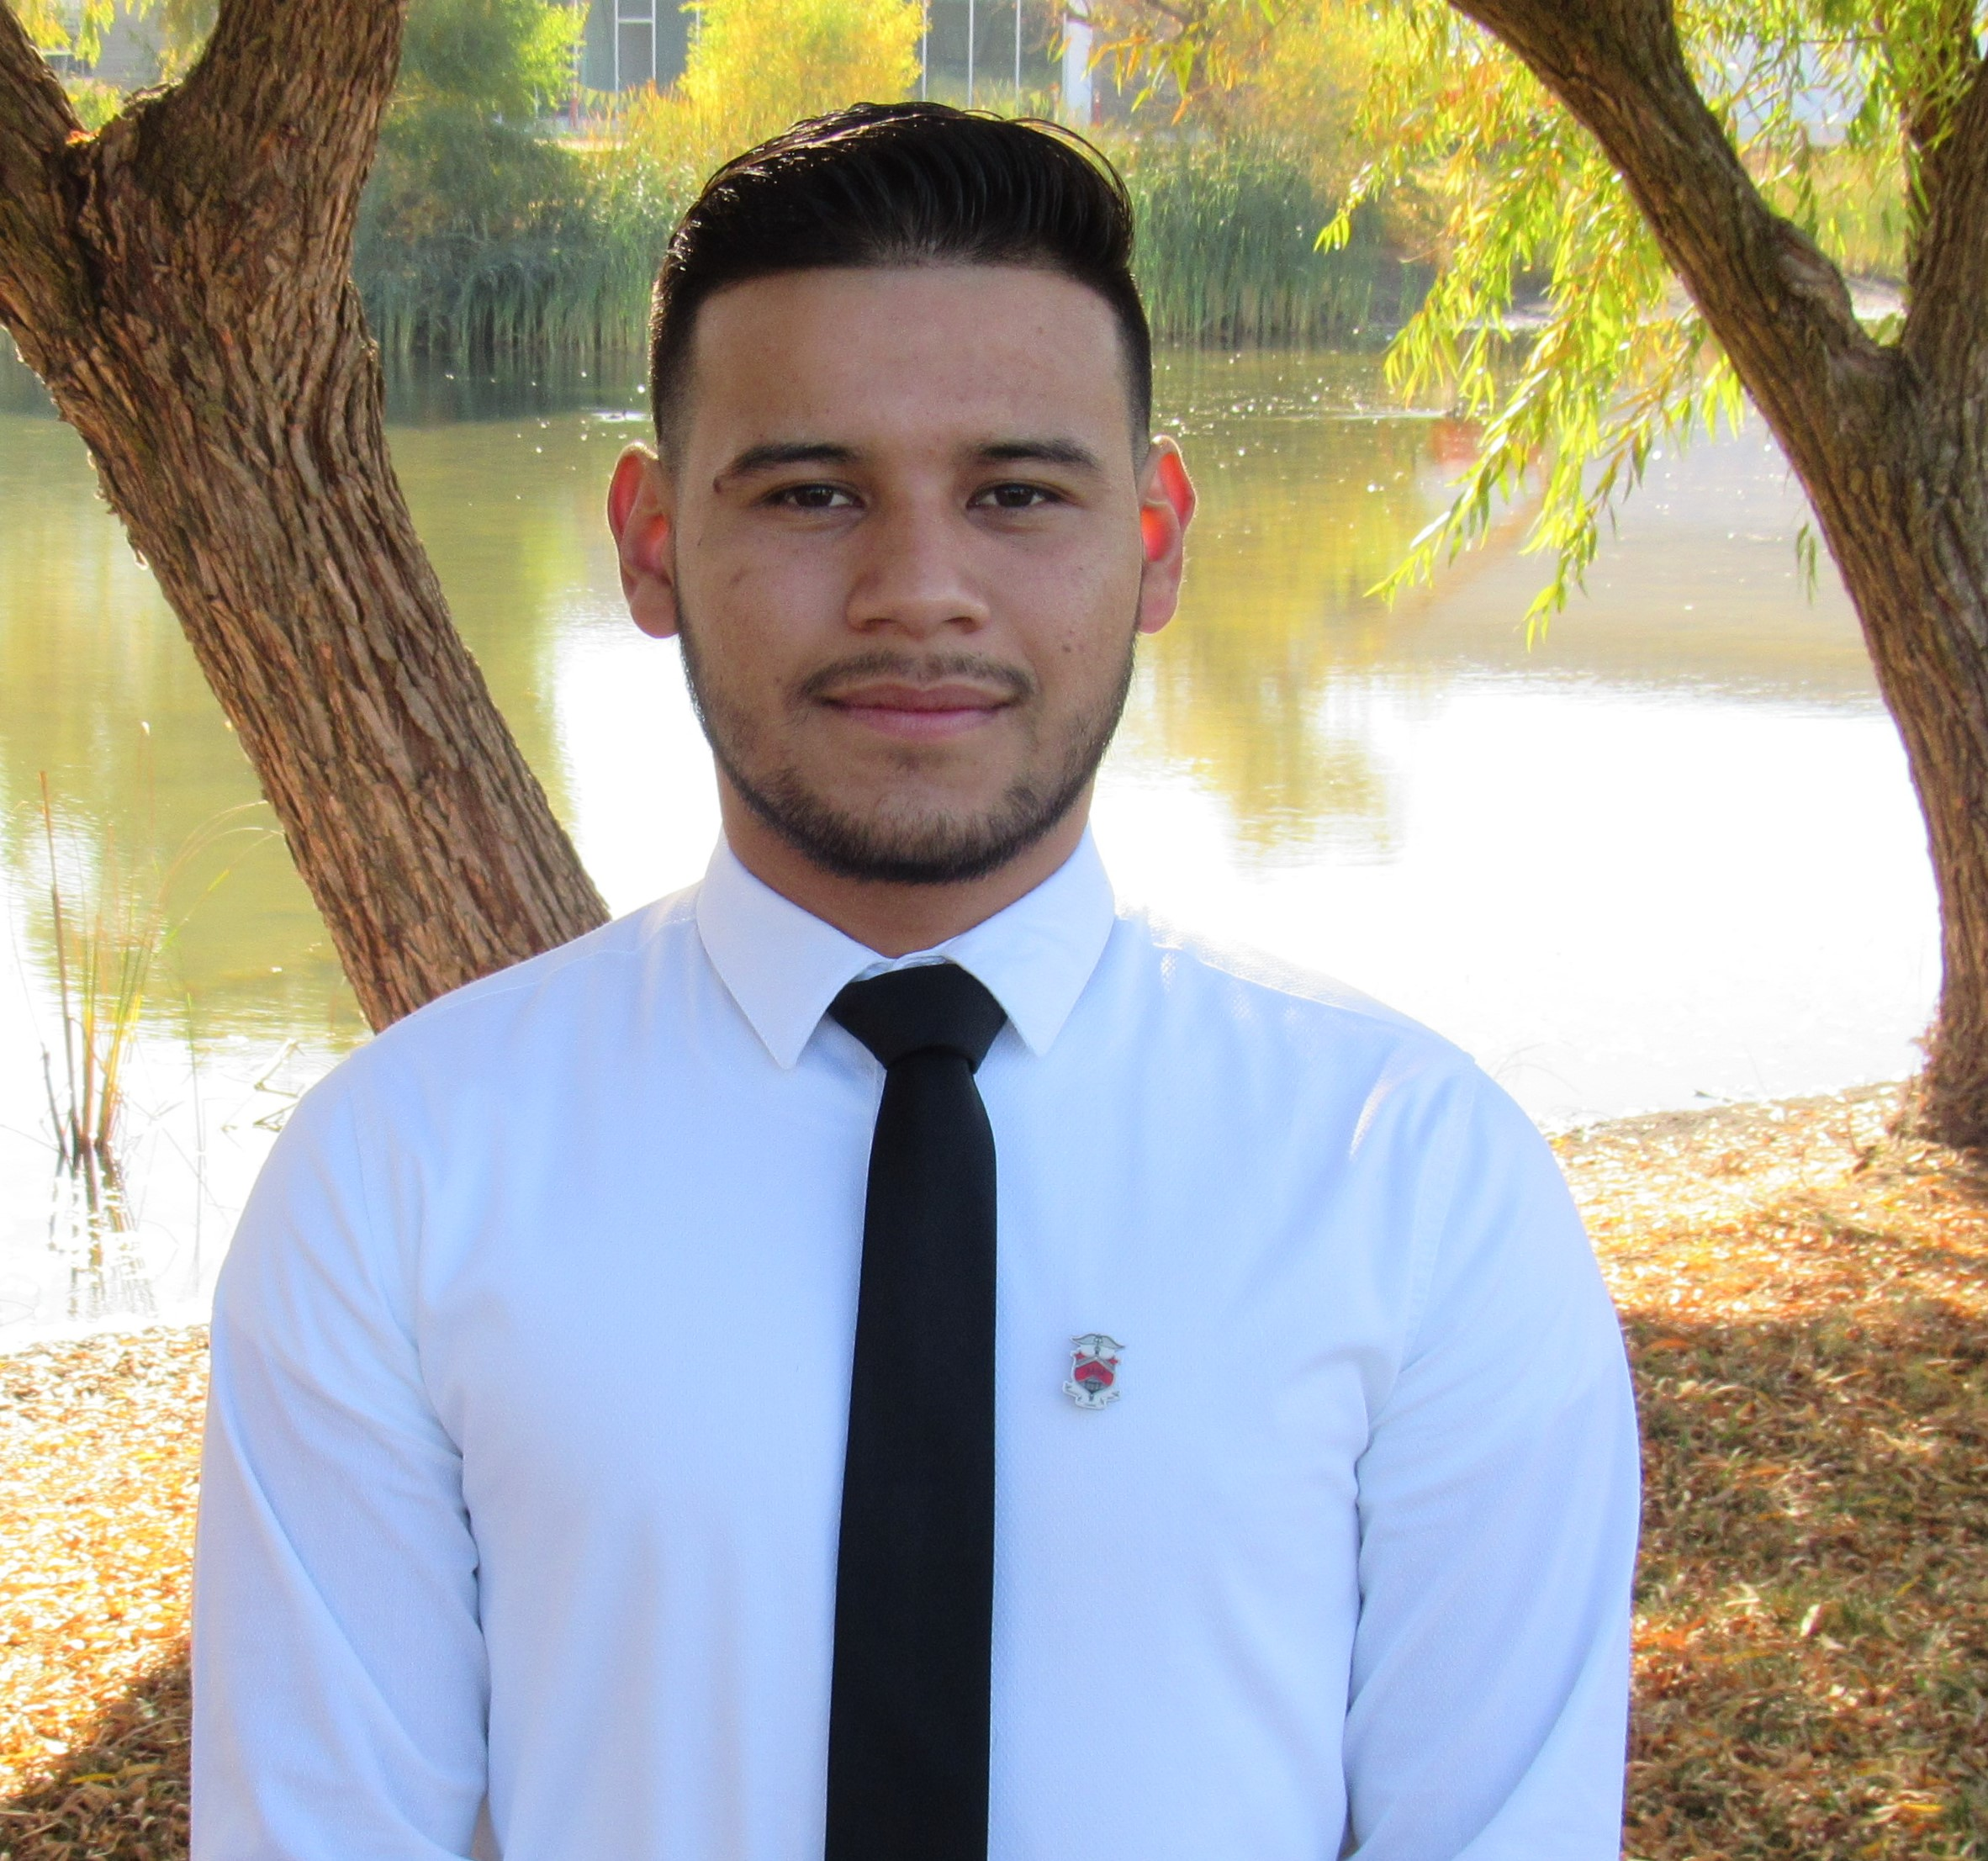
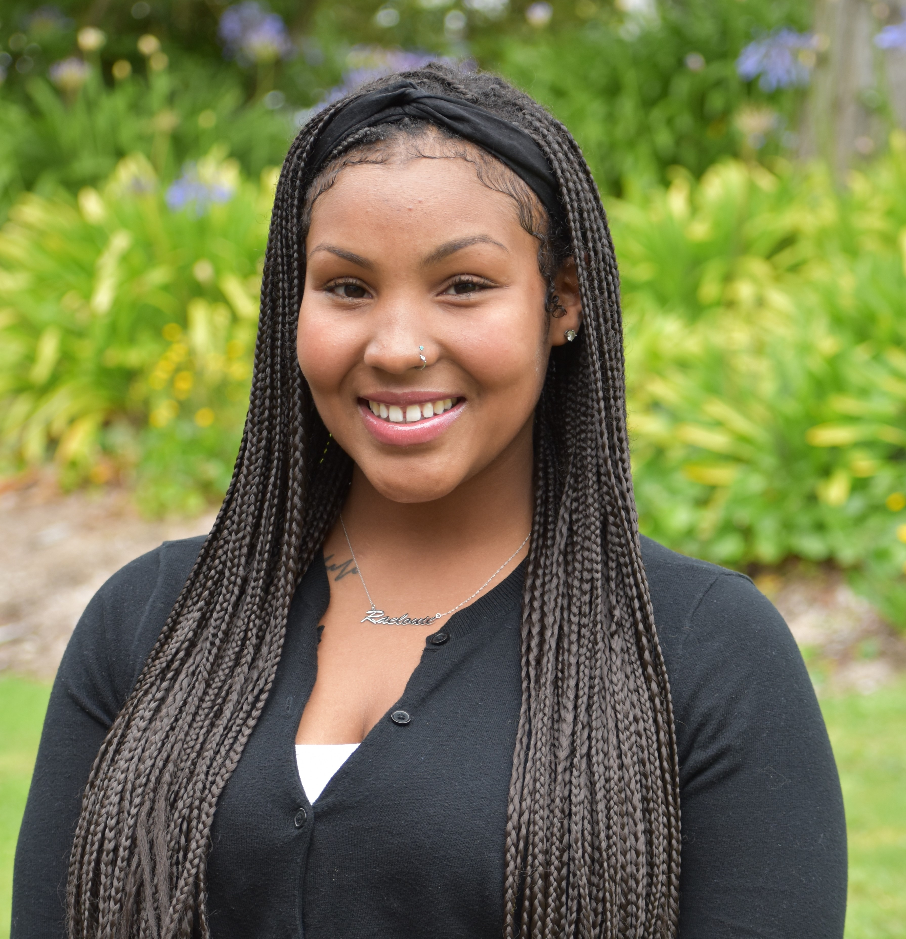
APP ALUMNI PANEL
Fresno State University/UC Merced
San Francisco State University
Griselda Aguilar, Fresno State
Chris Ramirez, SFSU
Sabrina Zamora, SFSU
Jose Garcia-Guerrero, UC Merced
Desirae Powell, SFSU
Notes:
Devon to moderate

Slide 11

QUESTIONS
Notes:
Paz- moderate questions in Chat

Slide 12

OPPORTUNITY
cseo.ucsf.edu/programs/inside-ucsf
Notes:
Connie

Slide 13

For questions about the application or APP program, please contact your campus program coordinator:
Leslie Giglio – Fresno State Program Coordinator
Leslie.Giglio@ucsf.edu
Carla Fernandez– SFSU Program Coordinator
Carla.Fernandez@ucsf.edu
Notes:
Leslie:
*for people who are ineligible or are interested in being added to the Listserv for future events, please email Leslie/Carla

